Slide 1

Yale School of Art’s Website
IHC – 1st Assignment
Ana Loureiro, 104063
Fábio Alves, 108016
Guilherme Andrade, 107696
DETI, Universidade de Aveiro
Aveiro, February 2024

Slide 2

Table of contents
01. Introduction
04. Our Severity Ratings
02. Evaluation Methods
05. Cognitive Walkthrough
03. Heuristic Evaluation

Slide 3

01. Introduction

Slide 4


Yale School of Art’s Website
Founded in 1869 in the USA
It is an ongoing collaborative experience, where all members of the SOA can add and edit the information on the website
Majority used by students and teachers, but can be accessed by everyone

Slide 5

02. Evaluation Methods

Slide 6
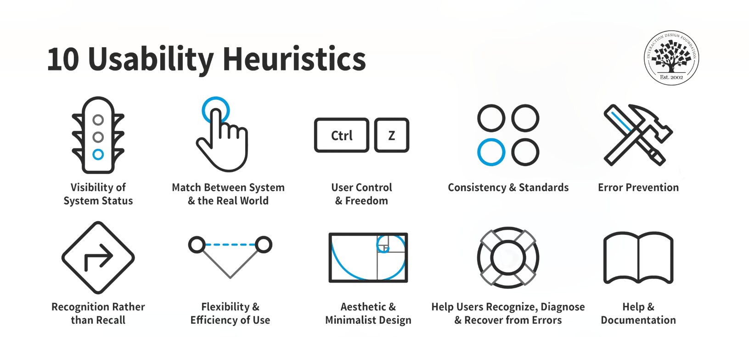
Jakob Nielsen's 10 general principles for interaction design

Slide 7
Severity Scale
Level of Severity | Classification | Color Association
Level 1 | Cosmetic Problem
Level 2 | Minor Usability Problem
Level 3 | Major Usability Problem
Level 4 | Usability Catastrophe

Slide 8
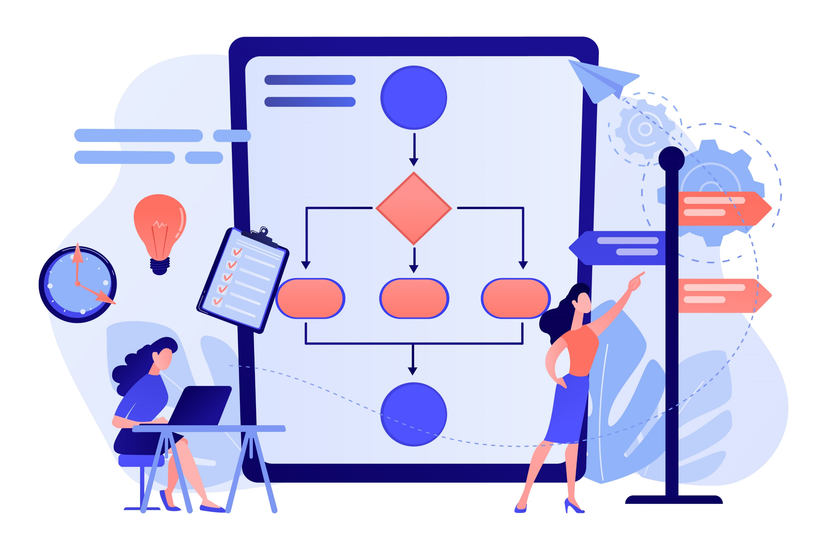
03. Heuristic Evaluation

Slide 9
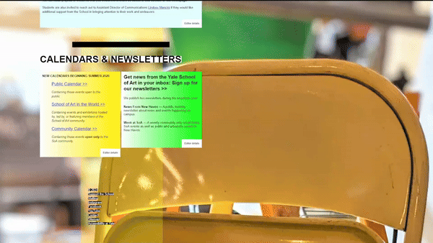
03. User Control and Freedom
Issue: No return button
Agreed Severity: 2 (1 vote)
Description: No way to return to the website after trying to subscribe to the newsletter
Notes:
Emergency button

Slide 10
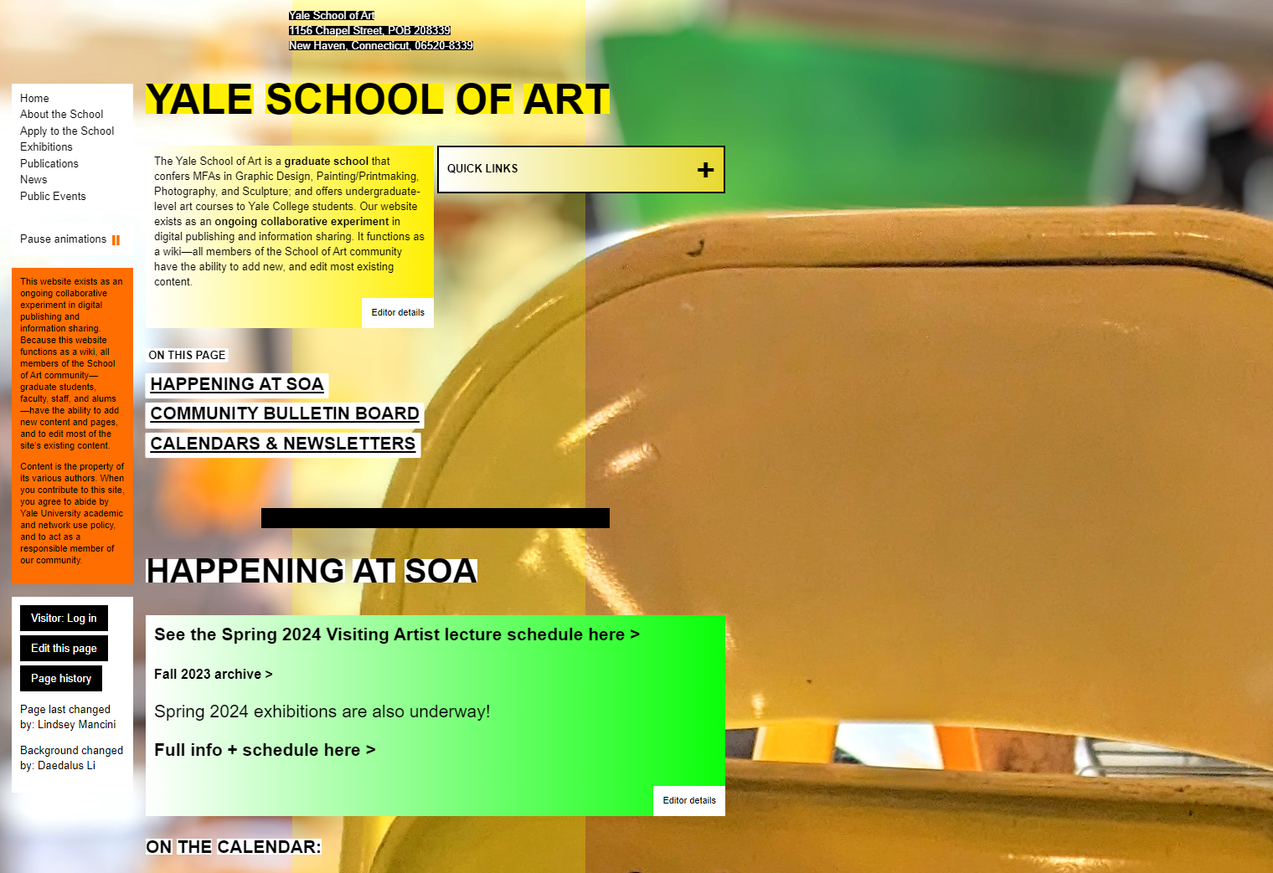
04. Consistency and Standards
Issue: Website’s layout
Agreed Severity: Each member gave a different severity level (1,2,3)
Description: The website has an incomprehensible layout
Notes:
Seguir template e normas de sites

Slide 11
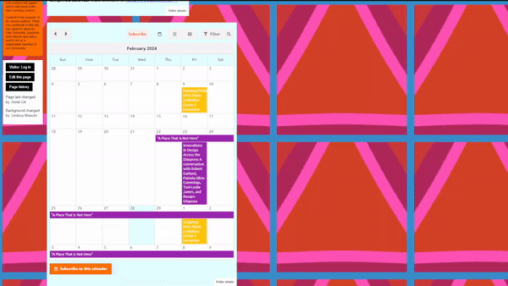
05. Error Prevention
Issue: Calendar interaction
Agreed Severity: 2 (1 vote)
Description: There’s no message when subscribing to the calendar feature
Notes:
Nao ter erros, ou mostrar mensagem, avisar user da sua acao

Slide 12
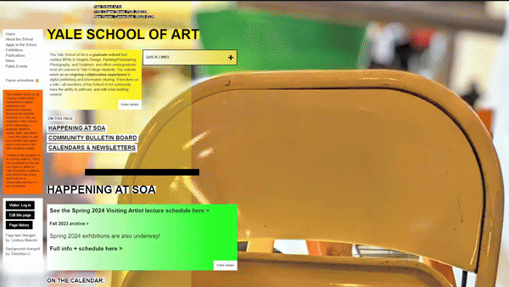
08. Aesthetic and Minimalist Design
Issue: Website’s graphical design
Agreed Severity: 4 (3 votes)
Description: The website is uncomfortable to look at due to the distracting gifs in the background, low contrast between the colors of the font and its message background, etc.

Slide 13
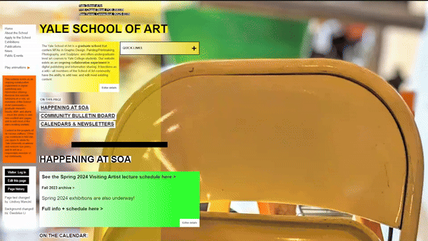
10. Help and Documentation
Issue: Help page very difficult to find
Agreed Severity: 2 (2 votes)
3 (1 vote)
Description: In order to get to the help page, you need to know it is found in the quick links, with the name ‘knowledgebase’. It is not included in the sitemap.

Slide 14

04. Our Severity Ratings

Slide 15
Ana
Fábio
Guilherme
03. User Control and Freedom
2
04. Consistency and Standards
3
1
2
05. Error Prevention
2
08. Aesthetic and Minimalist Design
4
4
4
09. Help Users Recognize,
Diagnose, and Recover from Errors
2
2
10. Help and Documentation
2
3
2

Slide 16

05. Cognitive Walkthrough

Slide 17
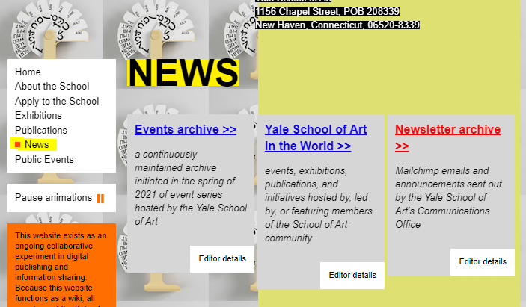
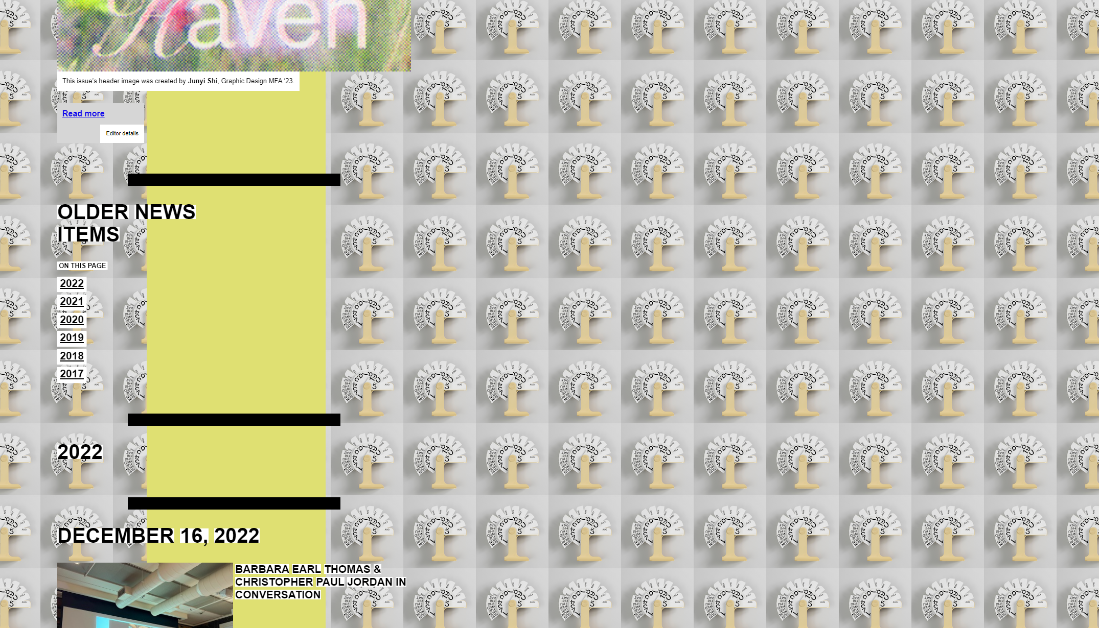
01. Task
Access the 2017 news using the "2017" filter button
02.User
An Ex Student of Yale School of Art
03.Issue
While trying to use the filter button the user notices that there is no filter button in the begginning of the news page
04.Question
Does the user know that he has to scrool down to find the filter button?

